Slide 1
Team106online
Sprint 5

Slide 2
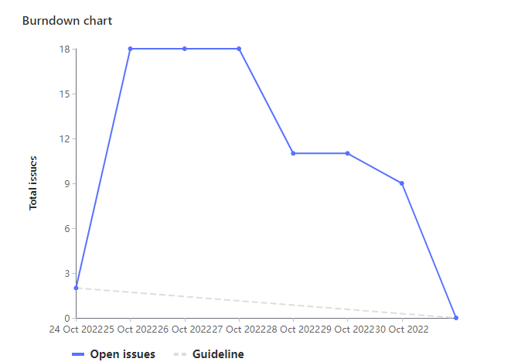
Sprint Progress

Slide 3
What Went Well
What To be Done Differently
Very effective UI design session
Able to get ahead on calendar functionality
Be more careful with merge conflicts
Setting a deadline for finishing up presentation slides

Slide 4
Team Member: Ivan Odiel Magtangob
Work Highlights:
Total Weights: 24
Sprint planning + meetings
UI design + implementation with Caleb, Parker, and Muhammad
Page routing in React with Alif, Rehan, and Hyrum

Slide 5
Team Member: Rehan Nagoor
Work Highlights:
Total Weights: 20
Contributed in using the flask endpoints
Contributed to getting, parsing and displaying the course list data
Researched Pandas to import the excel sheet data.

Slide 6
Team Member: Hyrum Nantais
Work Highlights:
Total Weights: 21
Setup and fix deployments on azure with Sam
Completed HTTP/SSL configuration including flask
Add example Calendar with Calen

Slide 7
Team Member: Samuel Guilbeault
Work Highlights:
Total Weights: 21
Setup and fix vm deployments on azure with Hyrum
Helped setup full HTTPS config on nginx
Worked with everyone to design UIs in Figma

Slide 8
Team Member: Muhammad Salmaan
Work Highlights:
Total Weights: 20
Designed UI templates on Figma .
Helped Ivan and Caleb with making different pages/ UI components for website.
Helped update readme and makefile.
Participated in weekly meetings and code review.

Slide 9
Team Member: Parker Carnegie
Work Highlights:
Total Weights: 21
Created and helped design website Figma project
Further researched NGINIX, react, JavaScript calendar libraries
Helped implement basic website UI

Slide 10
Team Member: Alif Merchant
Work Highlights:
Total Weights: 23
Updated section search prototype library to return JSON
Worked on creating api endpoints to search for sections
Added UI components to view list of all section

Slide 11
Team Member: Caleb Beere
Work Highlights:
Total Weights: 20
Worked with Ivan and Muhammad to create react components for our webpage
Continued to research NGINX
Worked with Parker, Ivan, Hyrum and Muhammad to design our webapp

Slide 12

Demo time!

